Slide 1
Evaluating the accuracy of cancer diagnostic tests

Slide 2

Many Ovarian Cancers Develop Genomic Instability
Genomic Instability is a feature of certain cancers and is caused by defective DNA repair, for example when the BRCA1 gene is lost
Why Measure Genomic Instability
A new class of drug is very effective at killing cancer cells that have Genomic Instability, but it is not toxic to normal cells.
Genomic Instability is now an important biomarker predicting benefit from these drugs. Patients whose tumors lack Genomic Instability will not benefit.
When BRCA1 is lost, double strand breaks don’t get repaired properly

Slide 3
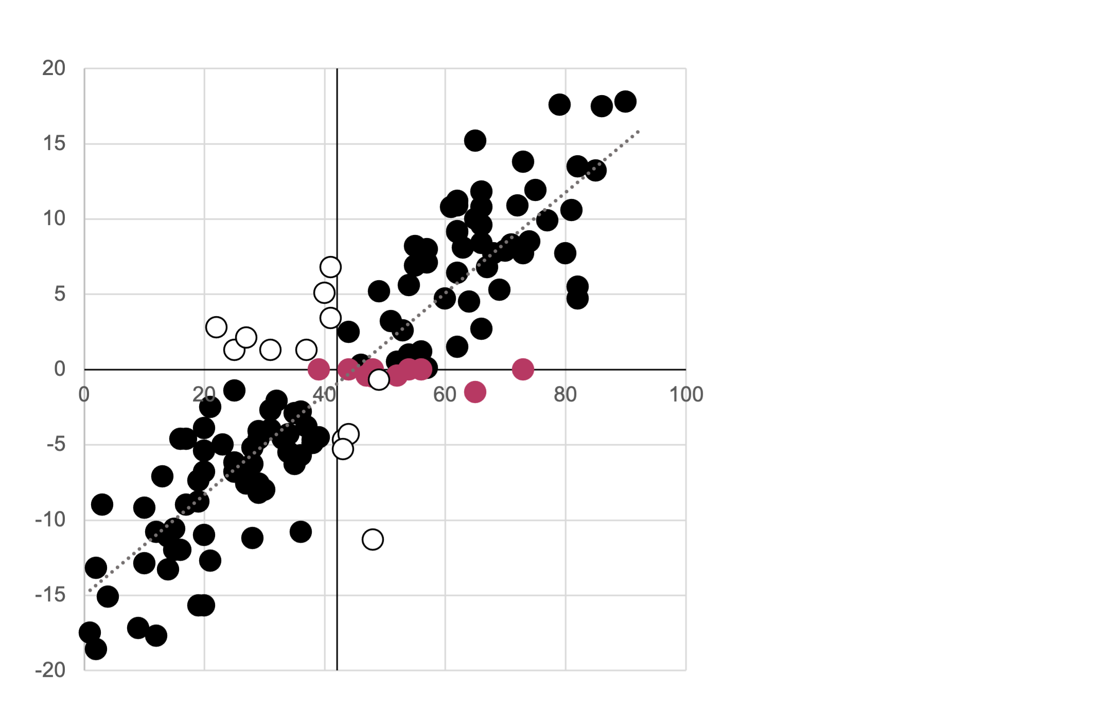
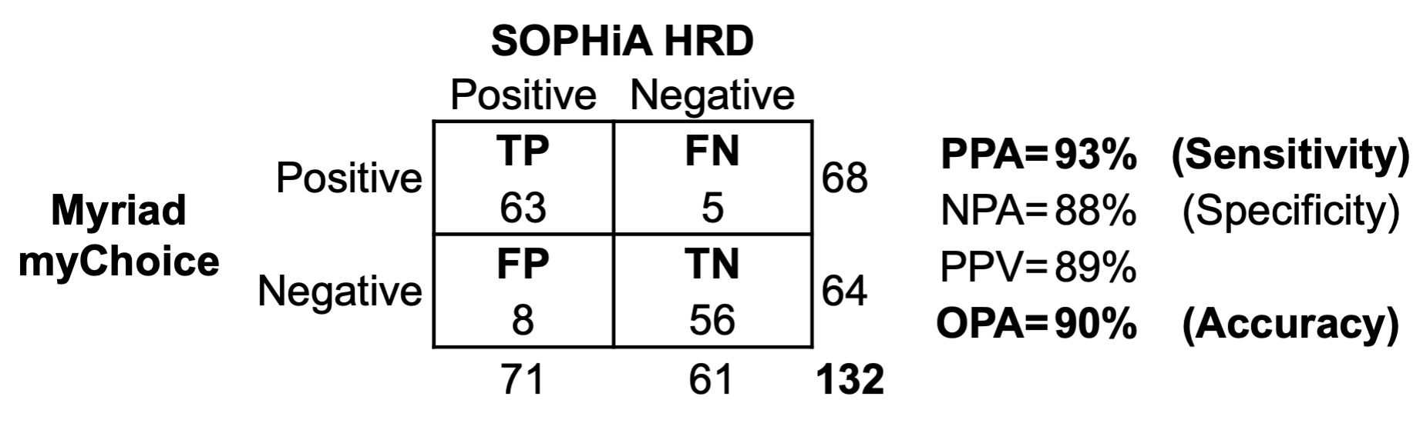
Tests that Measure Genomic Instability are not 100% accurate
We compared a Genomic Instability test from SOPHiA Genetics with a reference test from Myriad Genetics
SOPHiA Genetics agreed with Myriad Genetics only 93% of the time
SOPHiA GI Index
Myriad GI Score

Slide 4
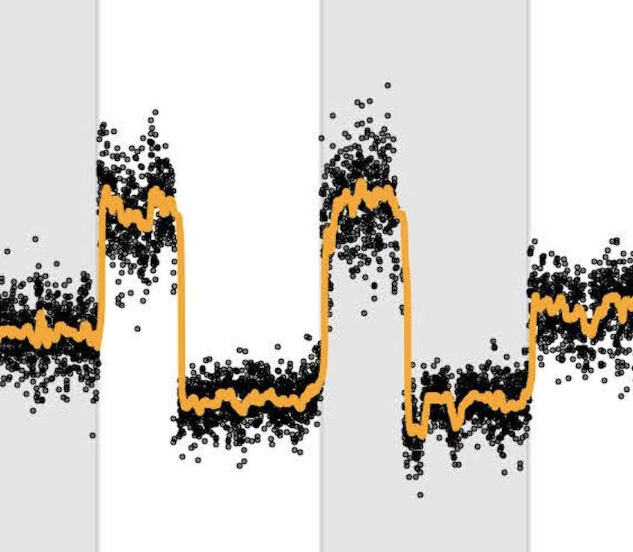
We asked, what characteristics of a test or sample is associated with disagreement?
Can we predict if a result generated by SOPHiA Genetics is at risk of being false without performing the Myriad Genetics reference test?
Each Myriad Genetics test generates several features that can be used to train a model that would help us accept or reject the cancer test result.
Normalized WGS coverage plot
Smoothed WGS coverage plot
The agreement, or lack of, between both tests, performed on our series of 139 ovarian cancer samples, can be used as the target for training our models.
Signal-Noise Ratio
Residual Noise
Signal
Purity-Ploidy Ratio

Slide 5

Methodology
(1) We obtained cancer test results from Peter MacCallum Cancer Centre and loaded all results into MongoDb. (2) We, cleaned, normalised and standardised the data in preparation for machine learning. (3) We used the data to train and test several predictive models. Model outcomes were also stored in MongoDb. (4) We produced accuracy reports and visualisations to determine whether our training was successful. (5) We applied our models to an independent set of test results to assess their ability to reject results at risk of being false.
Collect
Cleanse
Transform
Train
Predict
Data stored in .csv, .xlsx and .pdf file formats merged into a single .csv file using python scripts and loading into MongoDb.
We prepared the data for training by dropping redundant columns, ensuring only numerical and categorical values and imputing missing values.
We transformed the data for machine learning by employing one-hot encoding and StandardScalar transformation
We employed two machine learning approaches.
TensorFlow local neural network employing PCA and kerastuner optimisation.
SciKitLearn random forest employing cross-validation training
We applied our models to an independent set of test results.
We think neither model was a good fit for the size of our dataset.
Both types of machine learning are better suited to larger datasets.

Slide 6
Preprocessing and database
Peter MacCallum data was extracted from data files including .csv, .xlsx and .pdf . We used tabula-py and pdfplumber to automate reading of pdf files. Thirty-three columns of raw data were reduced to 24 columns of cleaned data by dropping redundant columns, one-hot encoding, imputation and StandardScalar transformation.

Slide 7
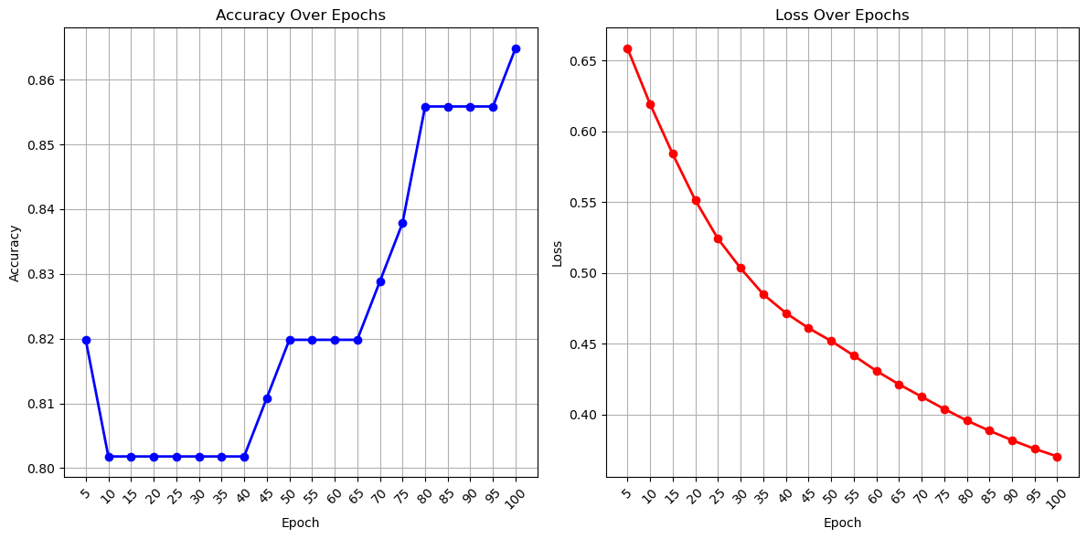
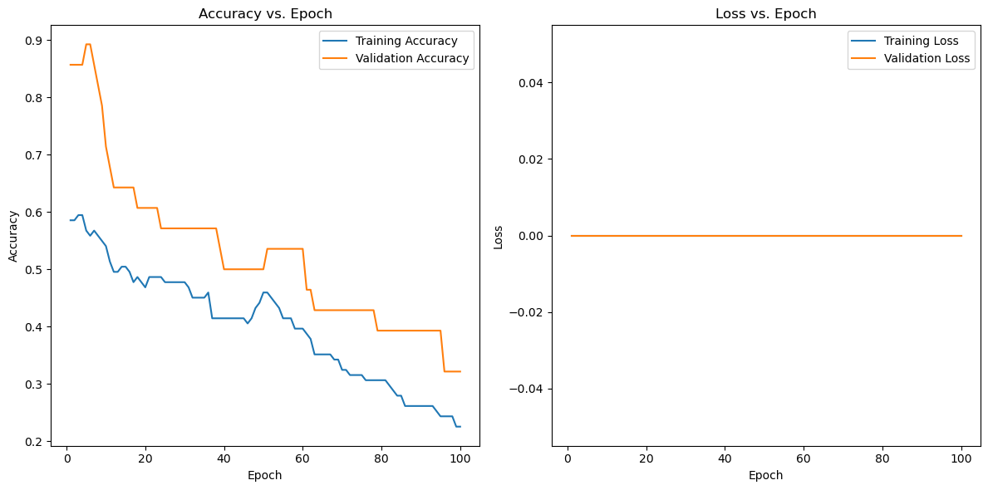
Neural Network Model

Slide 8
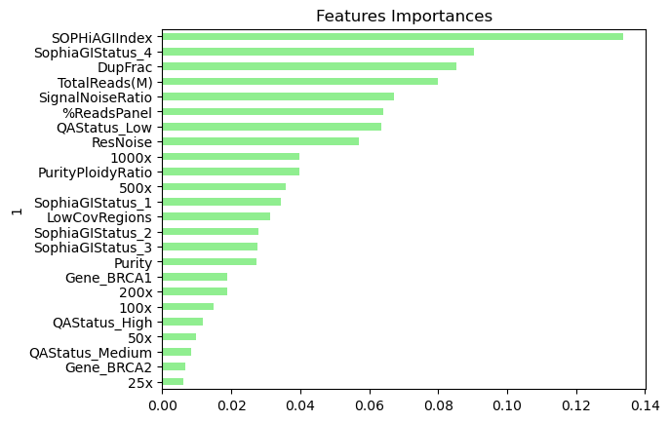
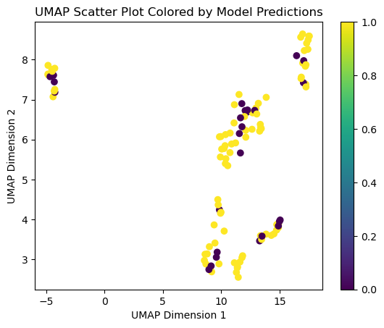
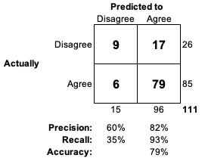
Random Forest Model
Due to the size of the training data, we also used a random forest algorithm with cross-validation. Advantages include better interpretability and less likelihood of overfitting compared to neural network algorithms
This model was quite good at predicting a correct test result (recall 93%) but very poor at predicting an incorrect test result (recall 35%)
We found that unexpected features are important in this model, suggesting we should revise which features to train on.
Unsupervised learning using the UMAP algorithm shows that disagreement can occur throughout the data space

Slide 9
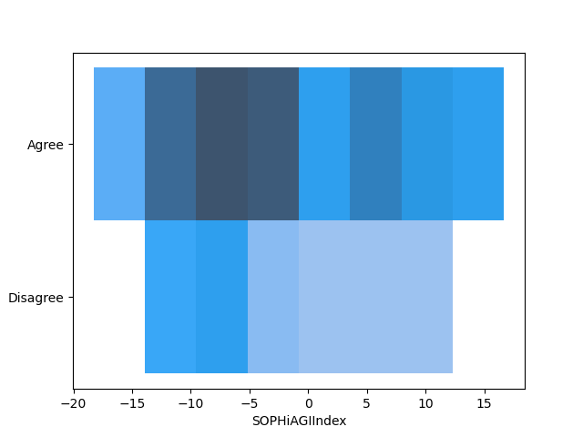
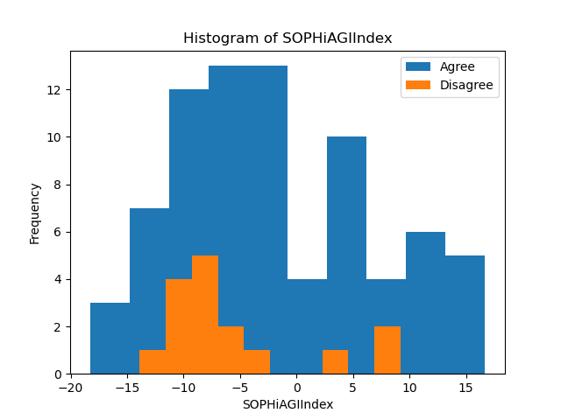
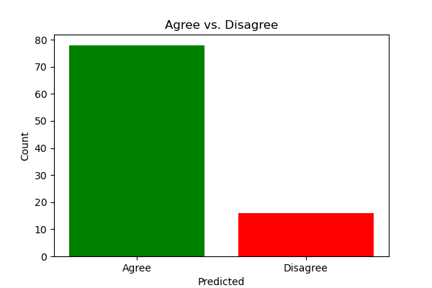
Predictions
We obtained SOPHiA Genetics test results on a further 94 clinical samples. No ‘gold standard’ reference result was available. We asked the models to predict if the test result was likely to be incorrect.
Comment.
Comment.
Comment.

Slide 10
Lessons learned and suggestions for Improvement
Our neural network approach …
Our random forest approach did not have high accuracy but revealed importance information about our training features.
Review training data, excluding features lacking logical explanation for high importance
Try using a logistic regression or support vector model. These models may be even better suited to our small dataset.

Slide 11

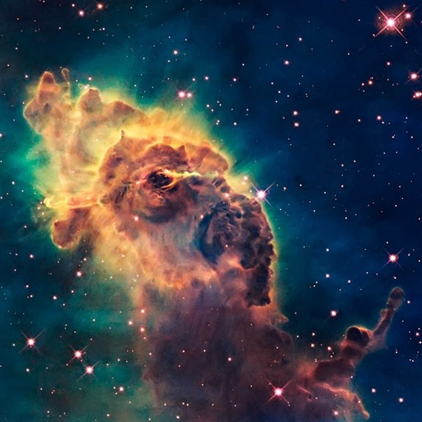


Thank you for listening We are: Andrew Fellowes Roberto Sammassimo Richard Soos Richard Thornton We are glad its over

